Slide 1
CS 170 Segment 4 adversarial search
Notes based from Dr. Eamonn Keogh

Slide 2
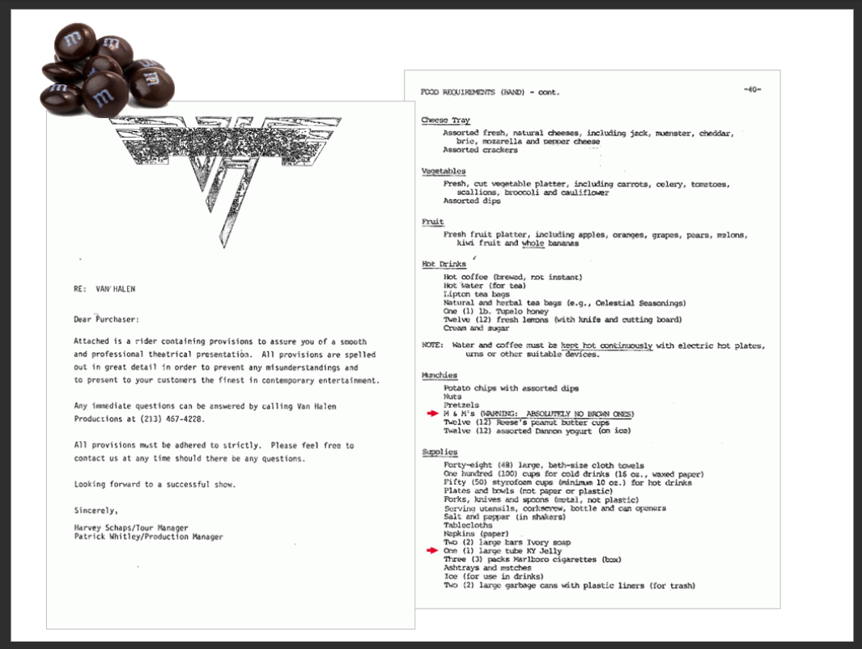

Slide 3
Adversarial Search (game playing search)
We have experience in search where we assume that we are the only intelligent entity and we have explicit control over the “world”
Let us consider what happens when we relax those assumptions. We have an enemy

Slide 4
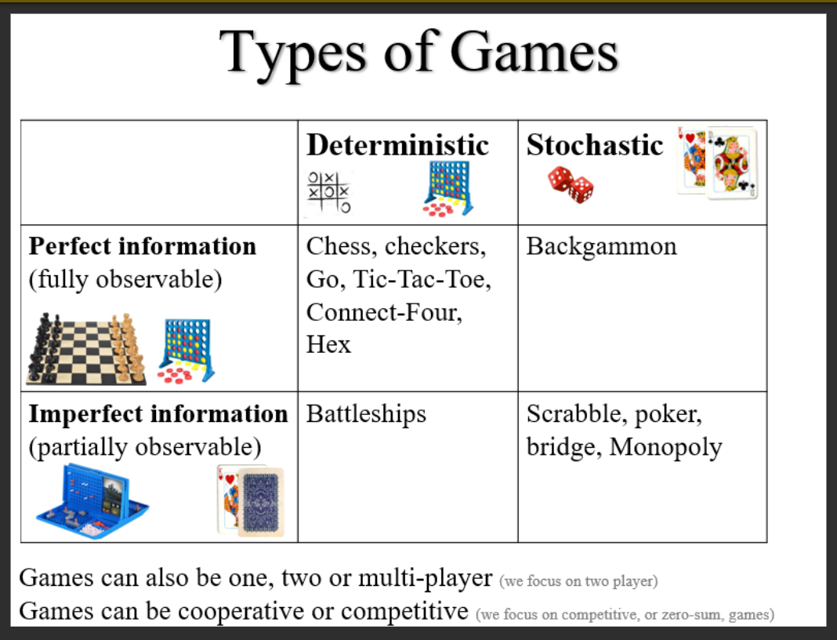

Slide 5
Two player games (deterministic, fully observable)
Max always moves first
Min is the opponent
We have
An initial state
A set of operators
A terminal test (which tells us when the game is over)
A utility function (evaluation function)
The utility function is like the heuristic function we have seen in the past, except it evaluates a node in terms of how good it is for each player. Positive values indicate states advantageous for Max, negative values indicate states advantageous for Min. Normally the closer to 1, the better things look for Max, the closer -1, the better things look for Min.

Slide 6
Two Player Games (deterministic, fully observable)
Max always moves first
Min is the opponent
We have
An initial state
A set of operators
A terminal test (which tells us when the game is over)
A utility function (evaluation function)
Sometimes the utility function can double as the terminal test. For example, if it returns exactly plus or minus 1.

Slide 7
Two Player Games (Deterministic, fully observable)
Assumption
We are assuming that both players are rational, and always make the optimal decision, with whatever information they have.

Slide 8
Adversarial Search Beyond Games
Adversarial search can be applied to economics, business, politics and war!
We will gloss over such considerations here

Slide 9
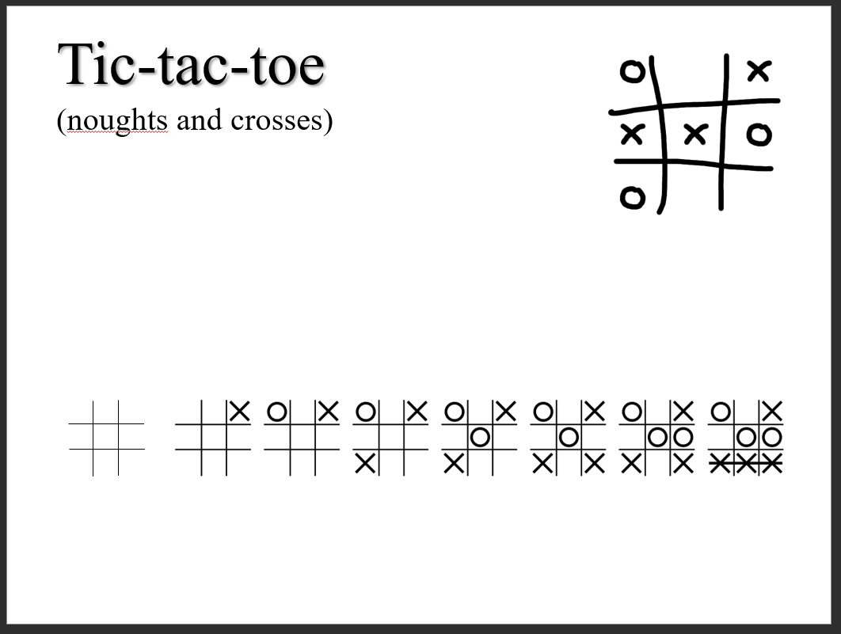

Slide 10
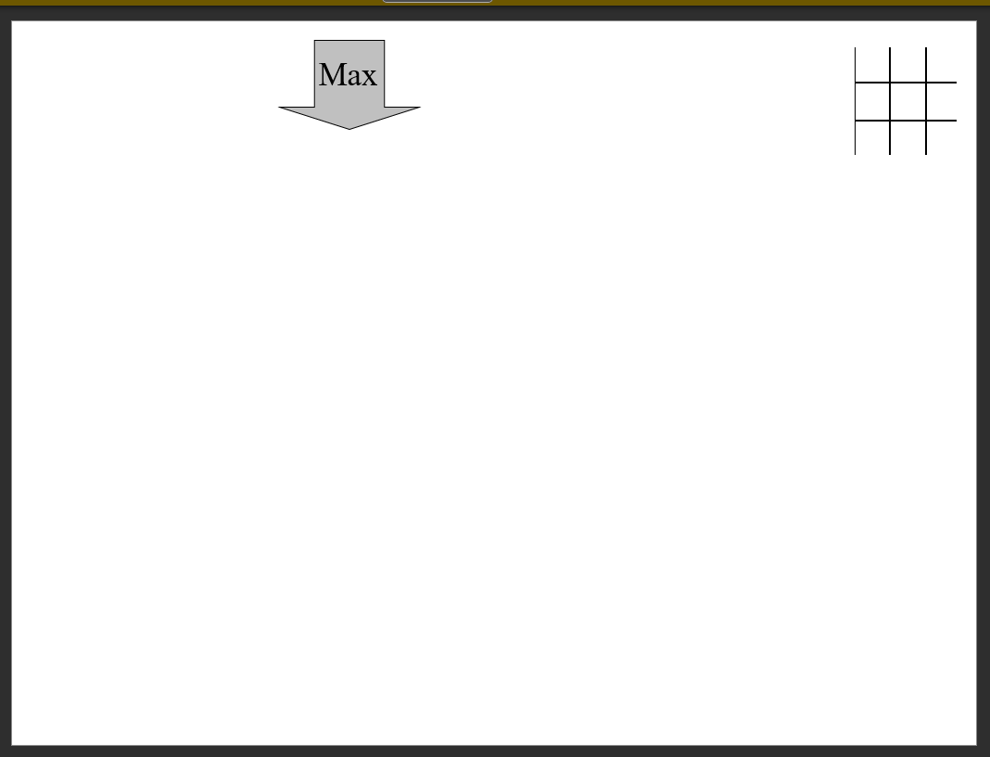

Slide 11
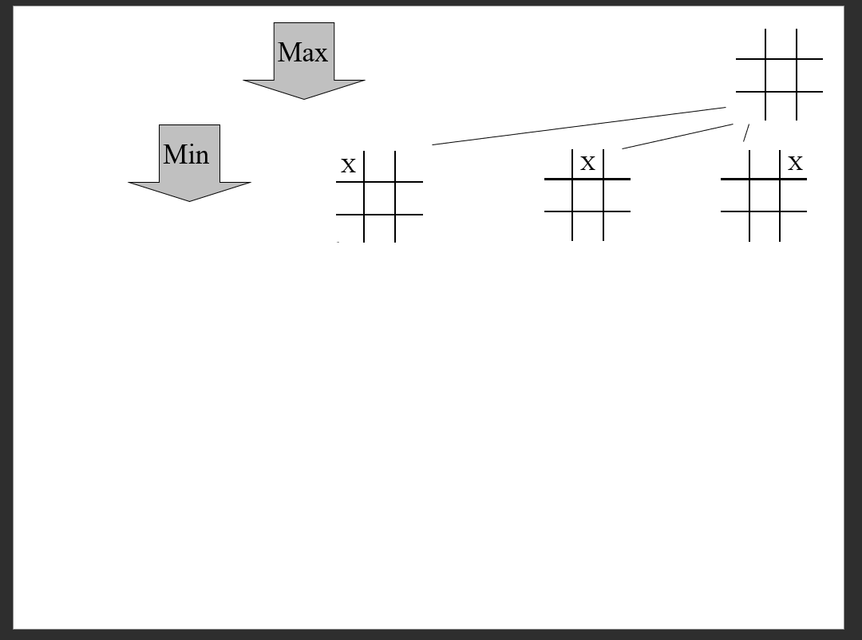

Slide 12
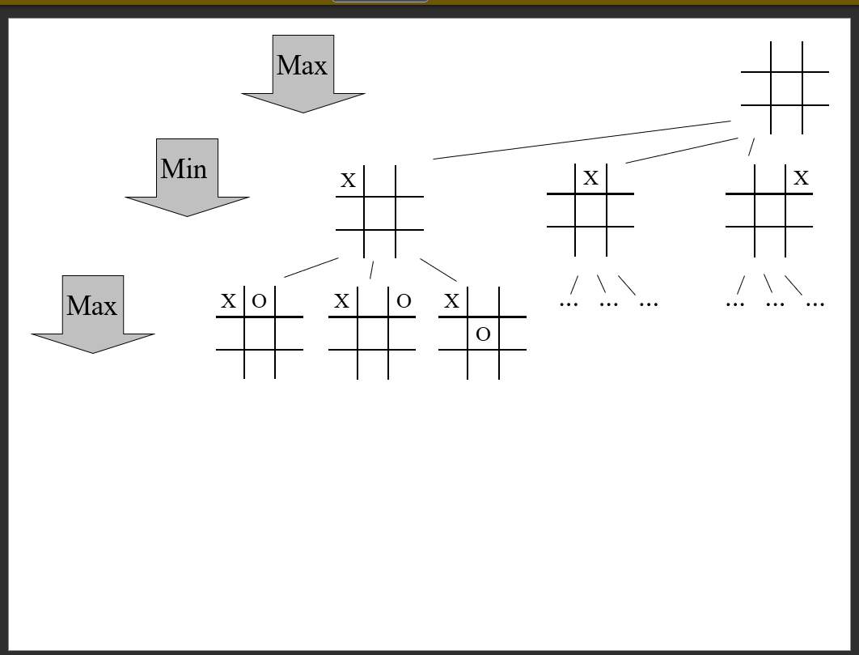

Slide 13
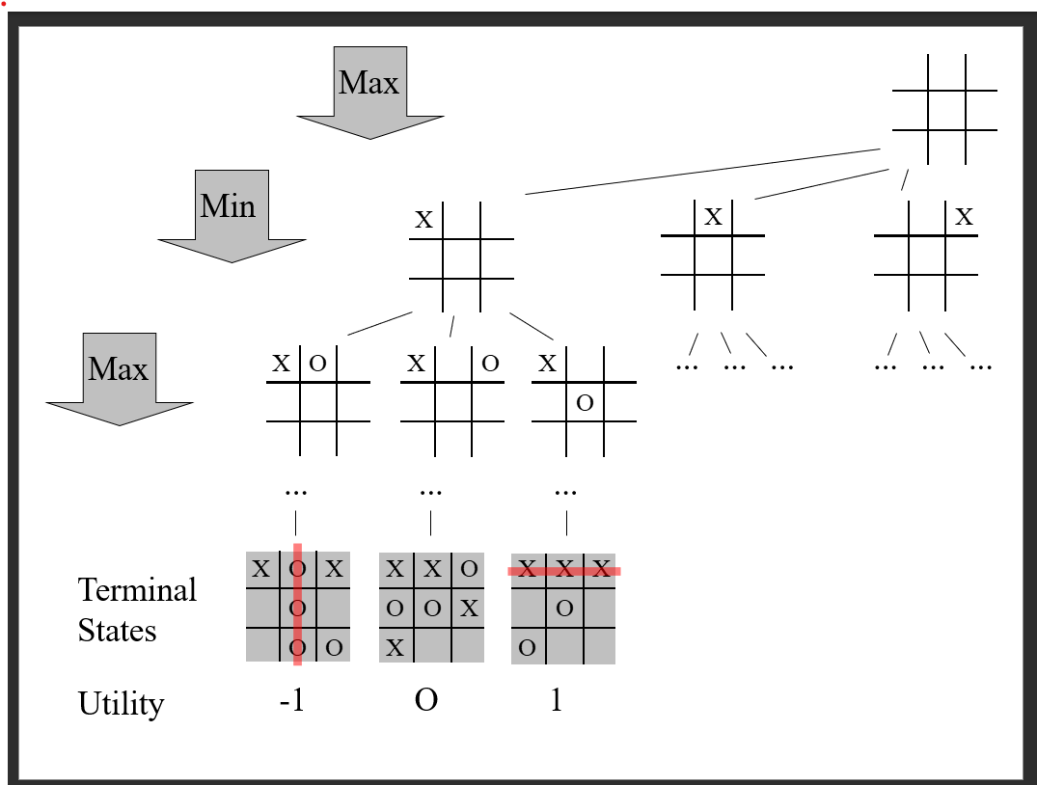

Slide 14
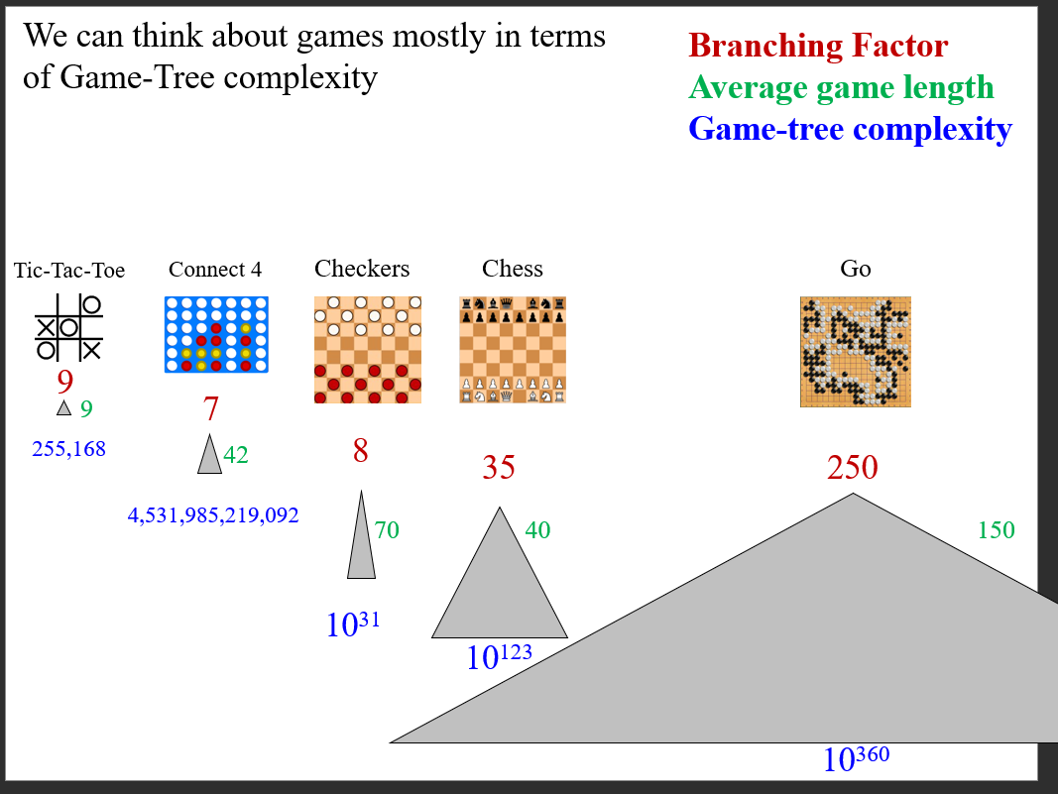

Slide 15
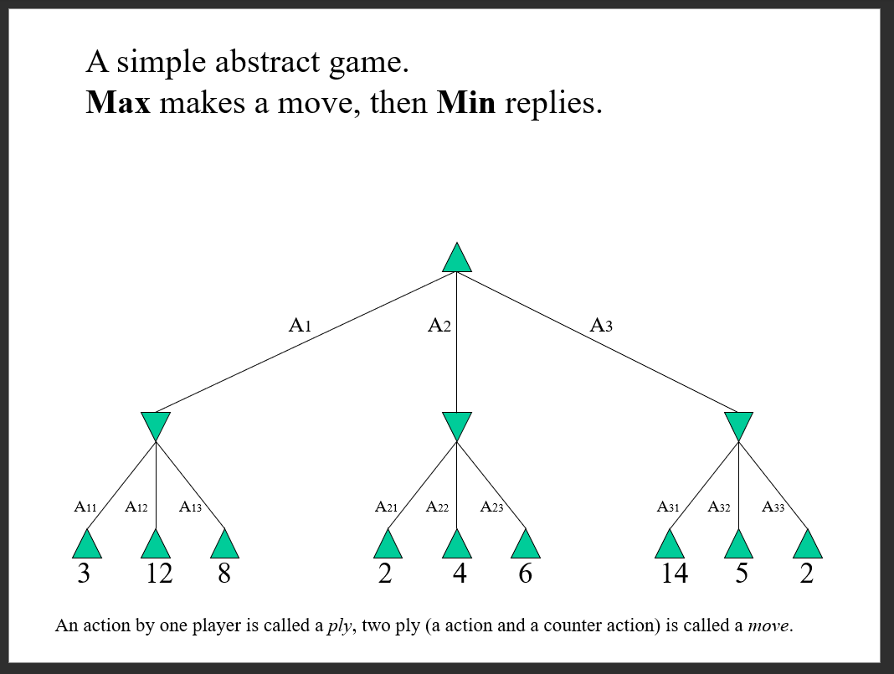

Slide 16
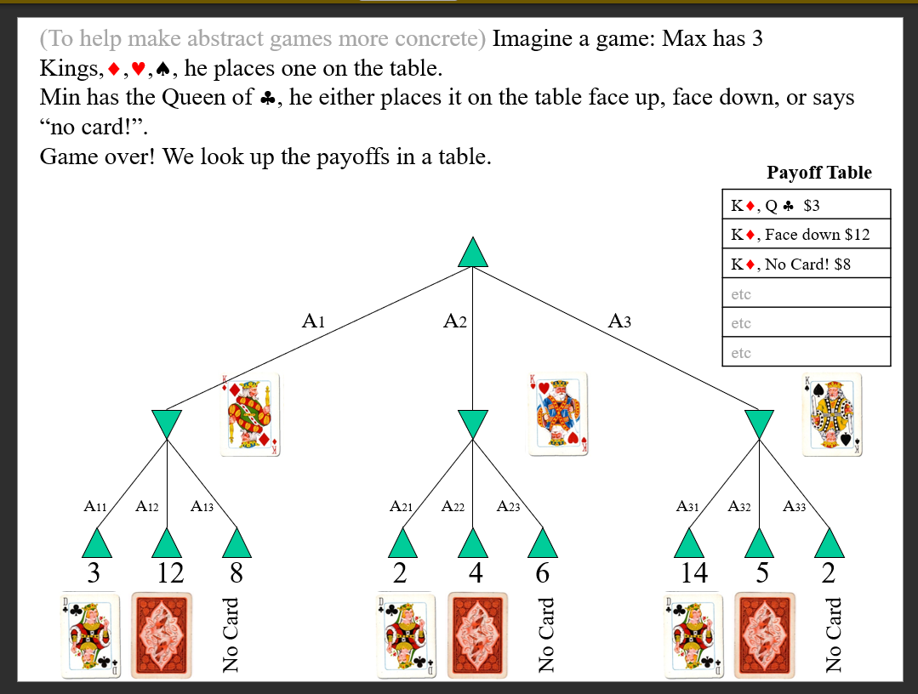

Slide 17
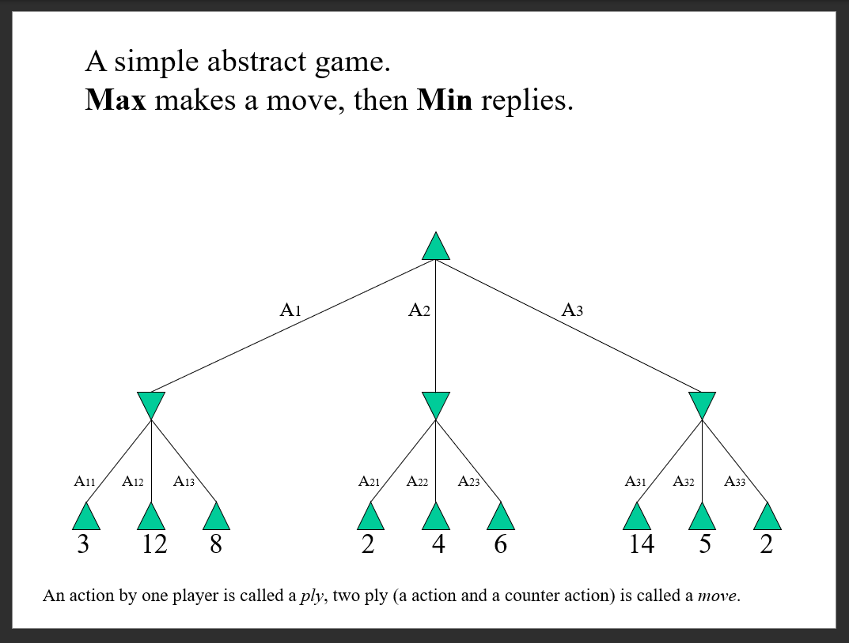

Slide 18
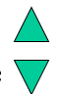
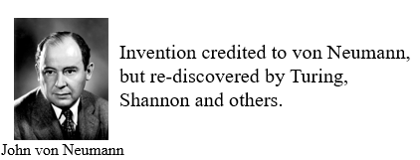
The Minimax Algorithm
Generate the game tree down to the terminal nodes
Apply the utility function to the terminal nodes
For a S set of sibling nodes, pass up to the parent..
The lowest value in S if the siblings are
The largest value in S if the siblings are
Recursively do the above, until the backed-up values reach the initial state
The value of the initial state is the minimum score for Max.

Slide 19
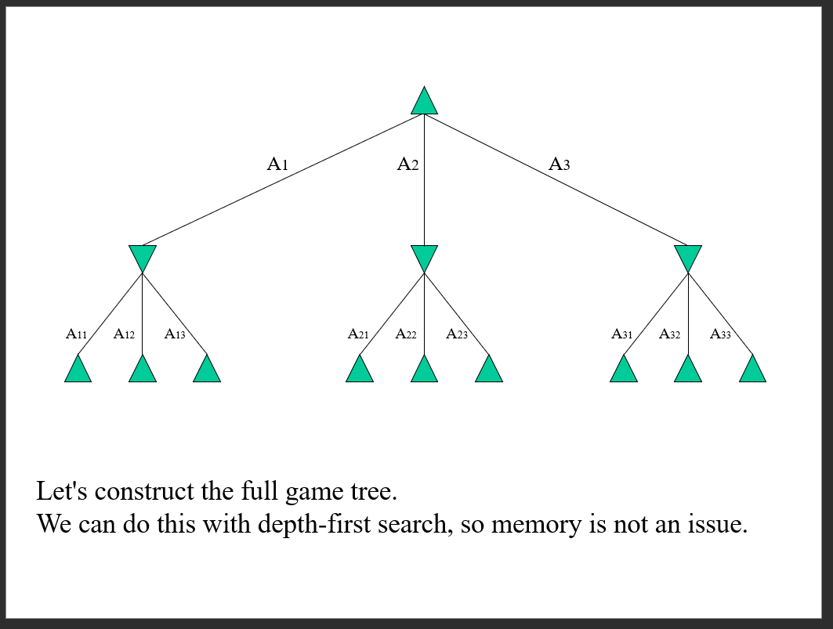

Slide 20
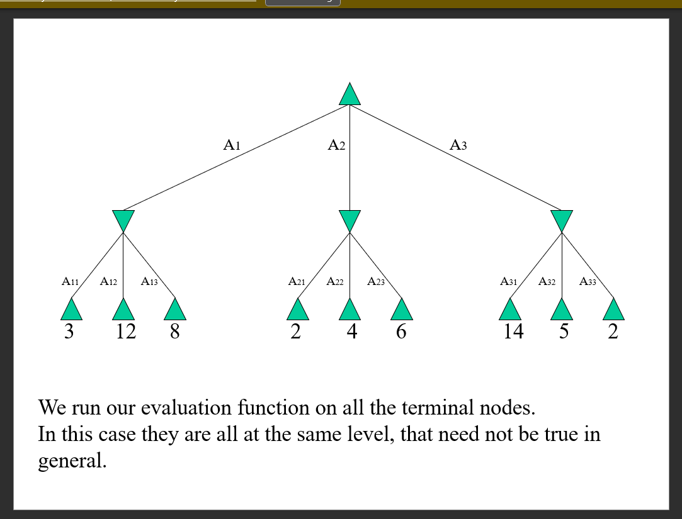

Slide 21
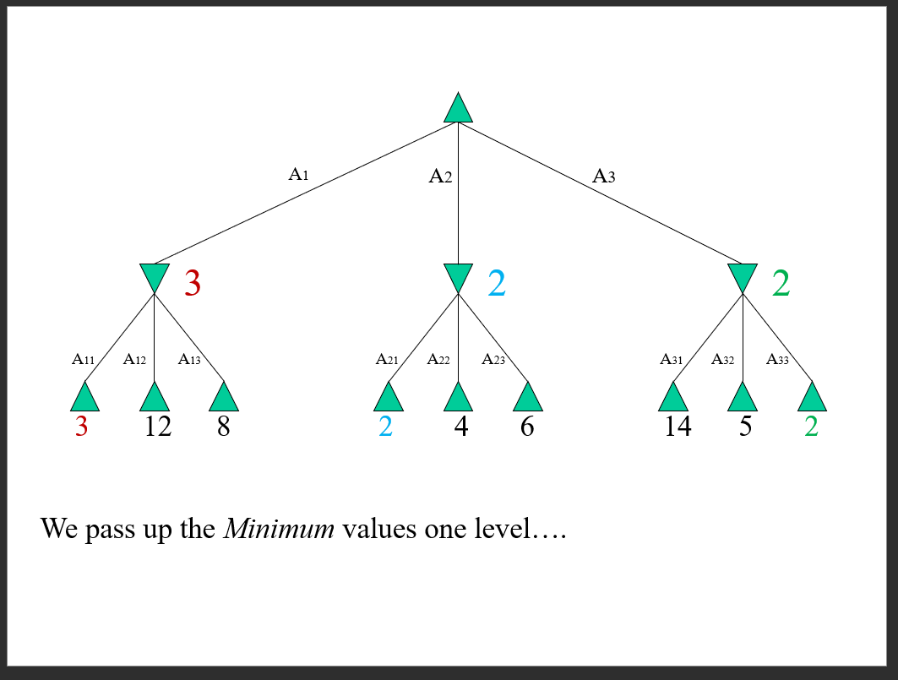

Slide 22
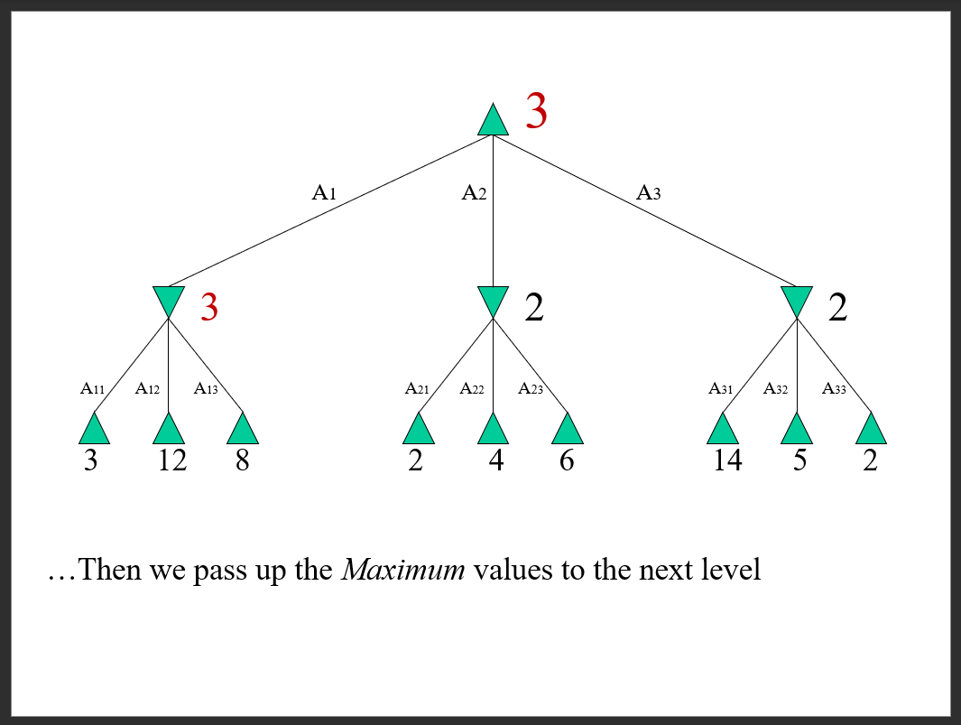

Slide 23
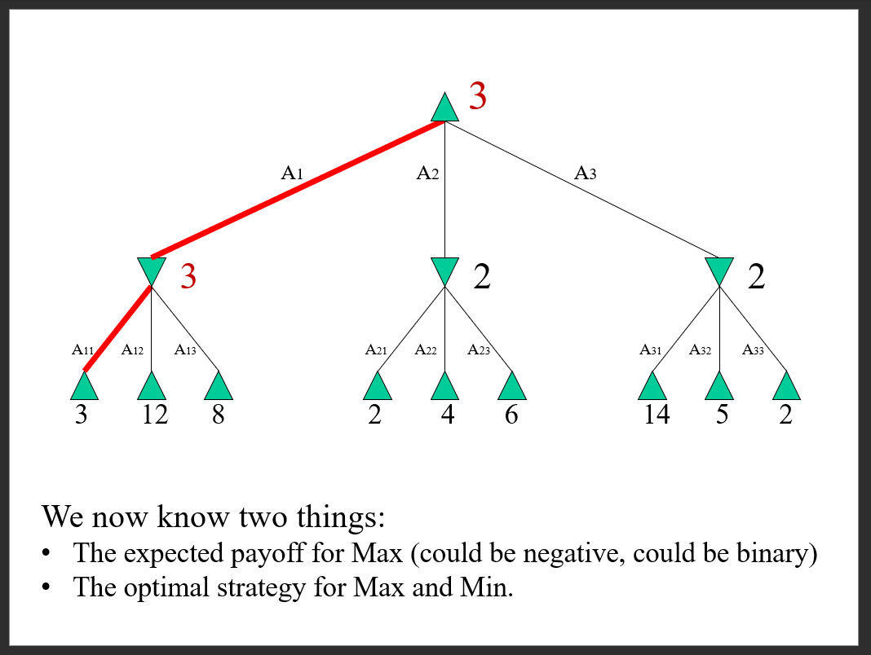

Slide 24
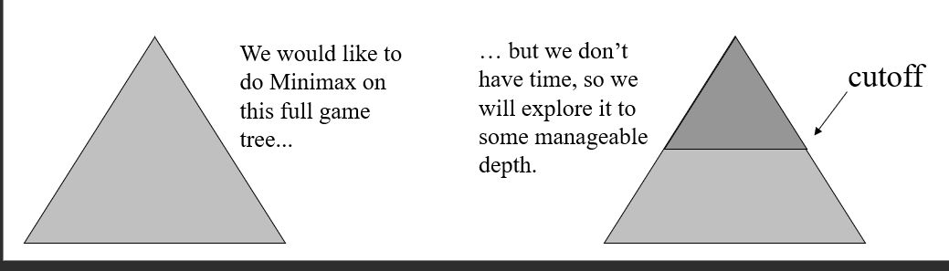
Although the Minimax algorithm is optimal, there is a problem…
The time complexity is O(b^m) where b is the effective branching factor and m is the depth of the terminal states.
(Note space complexity is only linear in b and m, because we can do depth-first search)
One possible solution is to do depth-limited Minimax search
Search the game tree as deep as you can in a given time
Evaluate the fringe nodes with the utility function
Back up the values to the root
Choose best move repeat

Slide 25
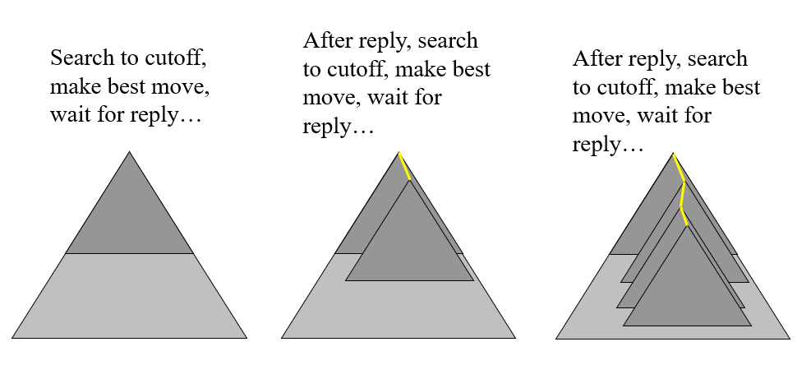
Depth Limited Minimax Search
Search the game tree as deep as you can in the given time
Evaluate the fringe nodes with the utility function
Back up the values to the root
Choose best move, repeat

Slide 26
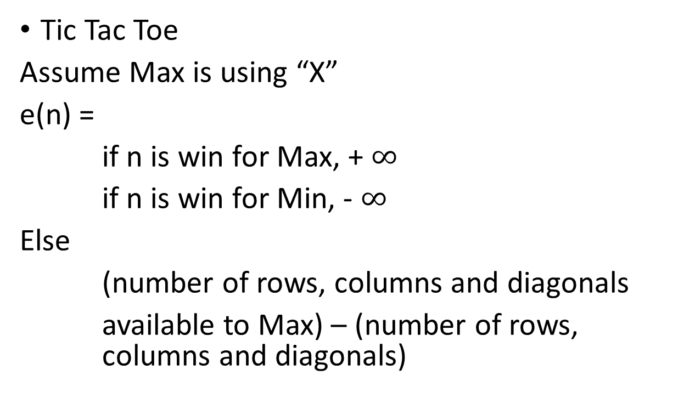
Example utility functions I
X
O
Tic Tac Toe
Assume Max is using “X”
e(n) =
if n is win for Max, + $∞$
if n is win for Min, - $∞$
Else
(number of rows, columns and diagonals
available to Max) – (number of rows, columns and diagonals)
e(n) = 6 - 4 = 2
O
X
X
O
e(n) = 4 - 3 = 1

Slide 27
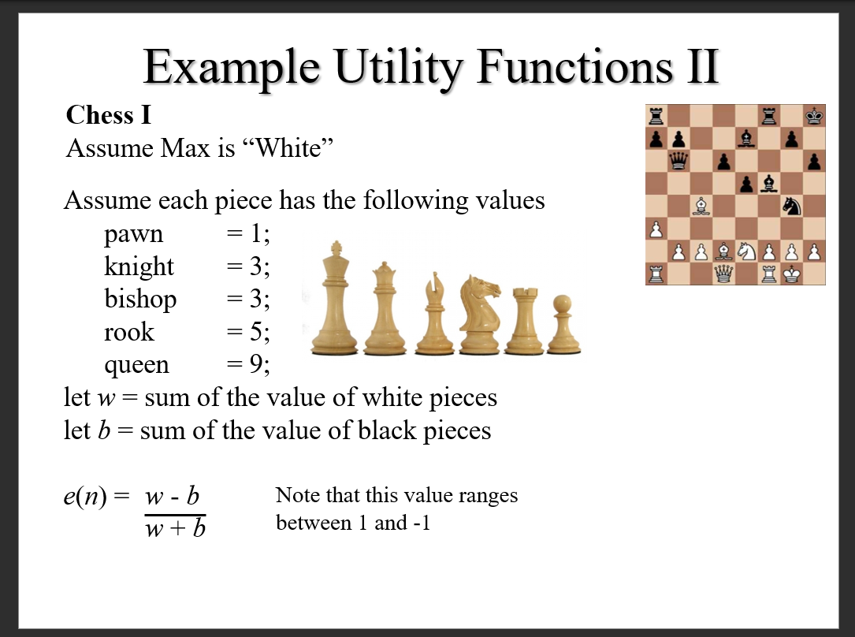

Slide 28
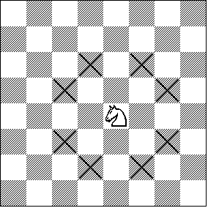
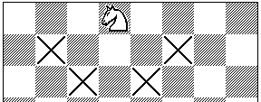
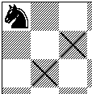
Example Utility Functions III
Chess II
The previous evaluation function naively gave the same weight to a piece regardless of its position on the board…
Let X_i be the number of squares the ith piece attacks
e(n) =
Piece1value*X1 + piece2value*X2 +…
I have not finished the equation. The important thing to realize is that the evaluation function can be a weighted linear function of the pieces value, and its position

Slide 29
Utility Functions
We have seen that the ability to play a good game is highly dependent on the evaluation functions
How do we come up with good evaluation functions
Interview an expert
Machine Learning

Slide 30
Take home Message
We cannot beat Minimax (but see Alpha-Beta below) for exact game playing
All our time should be spent on better utility function
Just like
We cannot beat A*, all our time should be spent on better heuristic functions

Slide 31
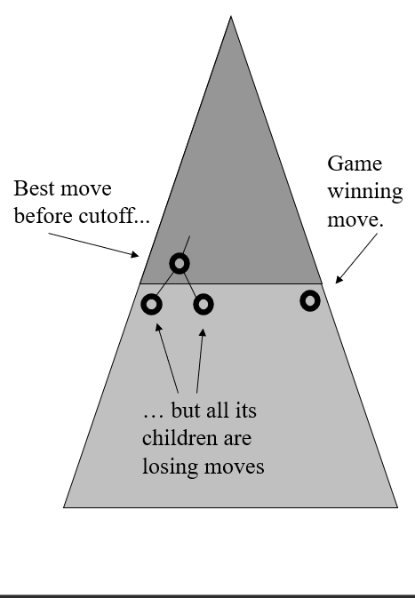
Alpha-Beta Pruning I
We have seen how to use Minimax search to play an optional game
We have seen that because of time limitations we may have to use a cutoff depth to make the search tractable. Using a cutoff causes problem because of the “horizon” effect
Is there some way we can search deeper in the same amount of time
Yes! Use Alpha-Beta Pruning

Slide 32
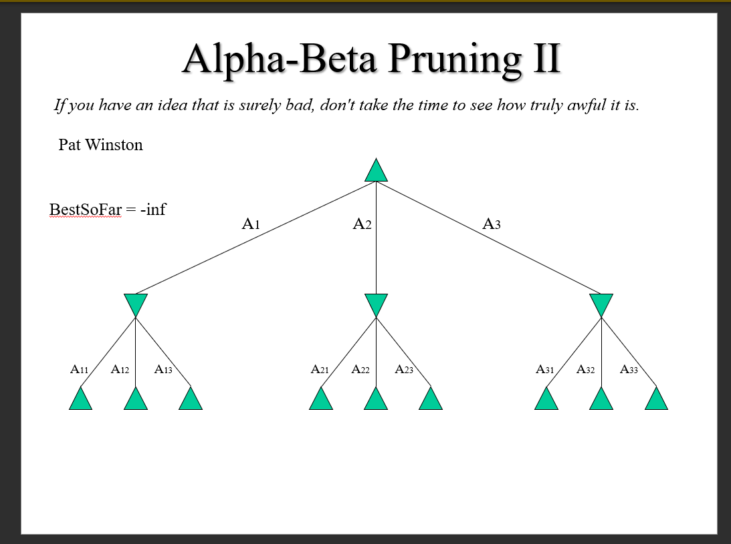

Slide 33
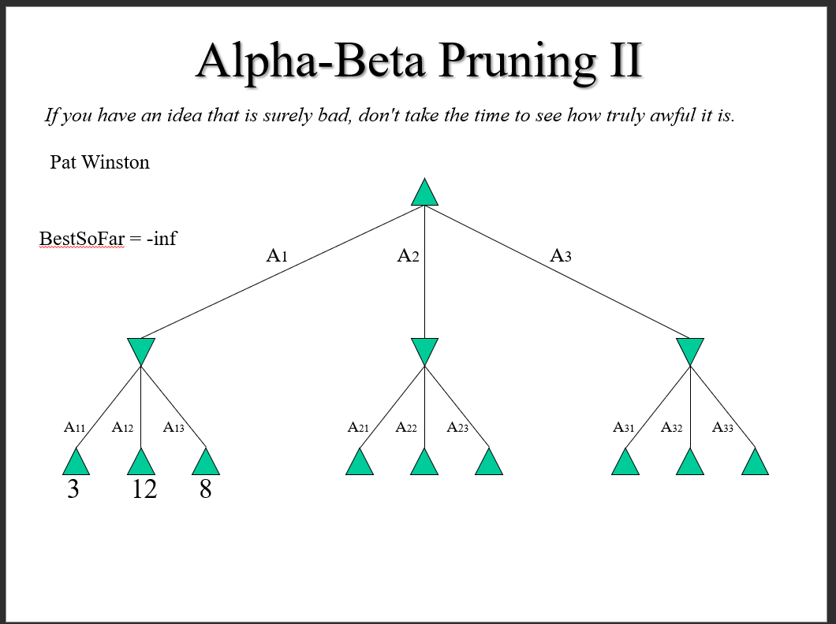

Slide 34
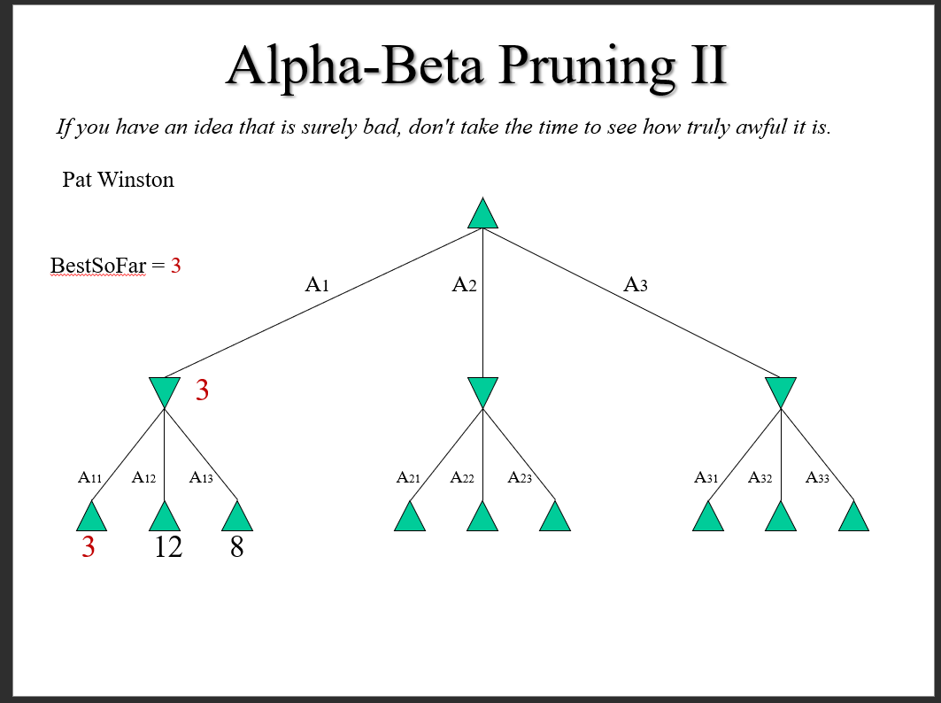

Slide 35
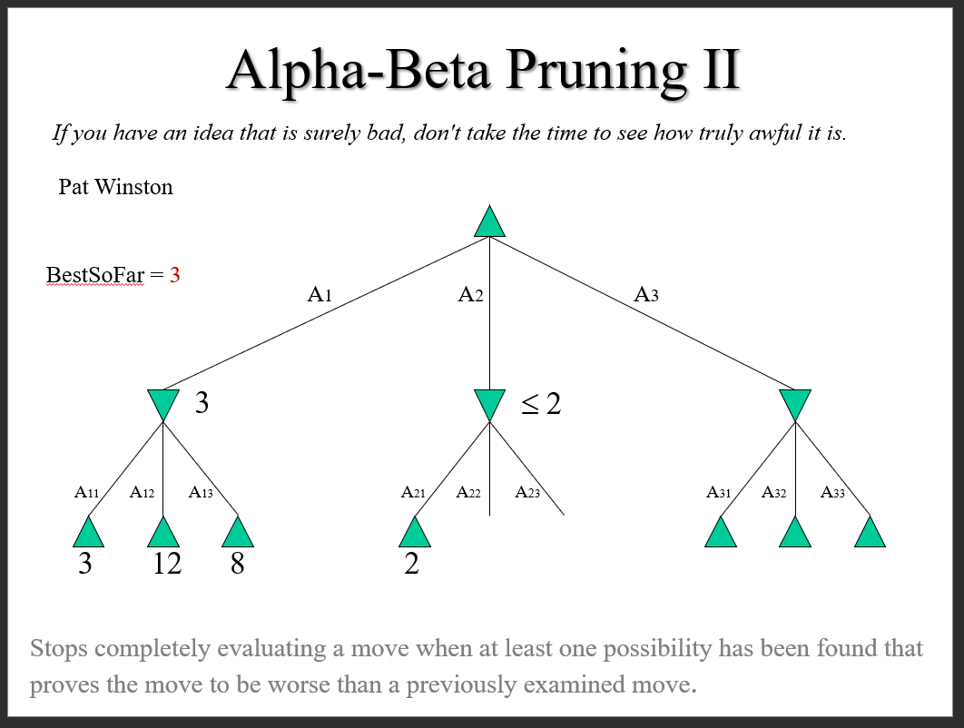

Slide 36
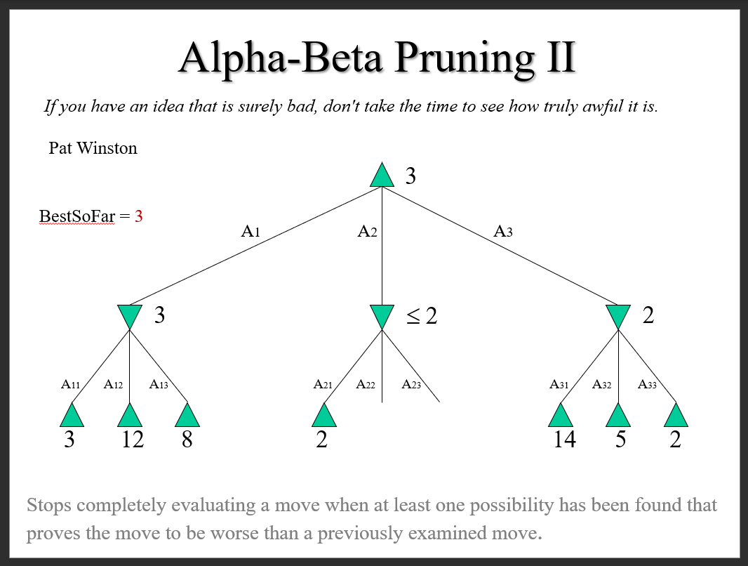

Slide 37
Alpha-Beta Pruning III
Alpha-Beta is guaranteed to compute the same Minimax value for the root node as computed by Minimax
In the worst case Alpha-Beta does NO pruning, examining b^d leaf nodes, where each node has b children and a d-ply search is performed
In the best case, Alpha-Beta will examine only 2b^{d/2} leaf nodes. Hence if you hold fixed the number of leaf nodes when you can search twice as deep as Minimax!
The best case occurs when each player’s best move is the leftmost alternative (i.e. the first child generated). So, at MAX nodes the child with the largest value is generated first and at MIN nodes the child with the smallest value is generated first. This suggest that we should order the operators carefully
In the chess program Deep Blue, they found empirically that Alpha-Beta pruning meant that the average branching factor at each node was about 6 instead of about 35-40

Slide 38
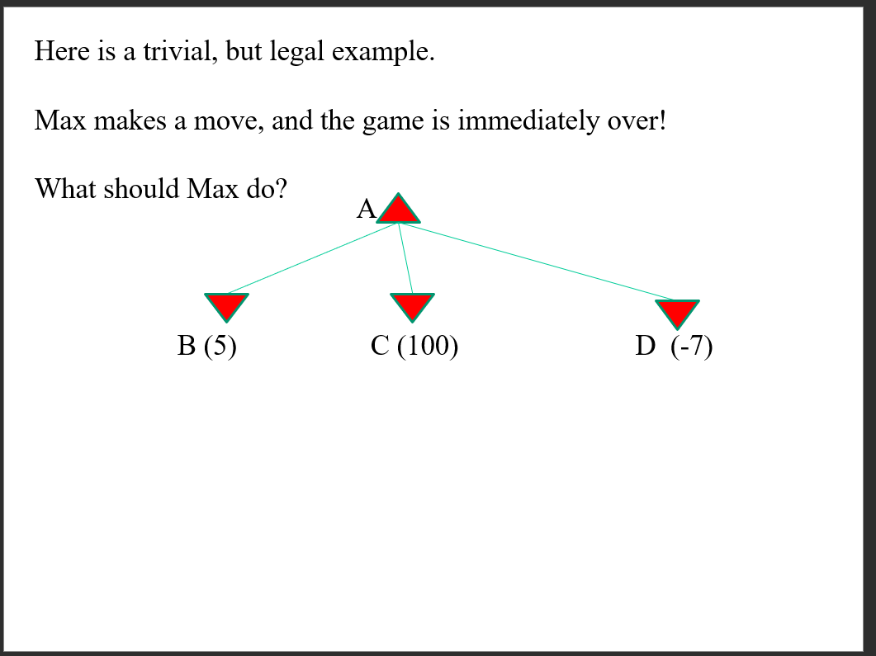

Slide 39
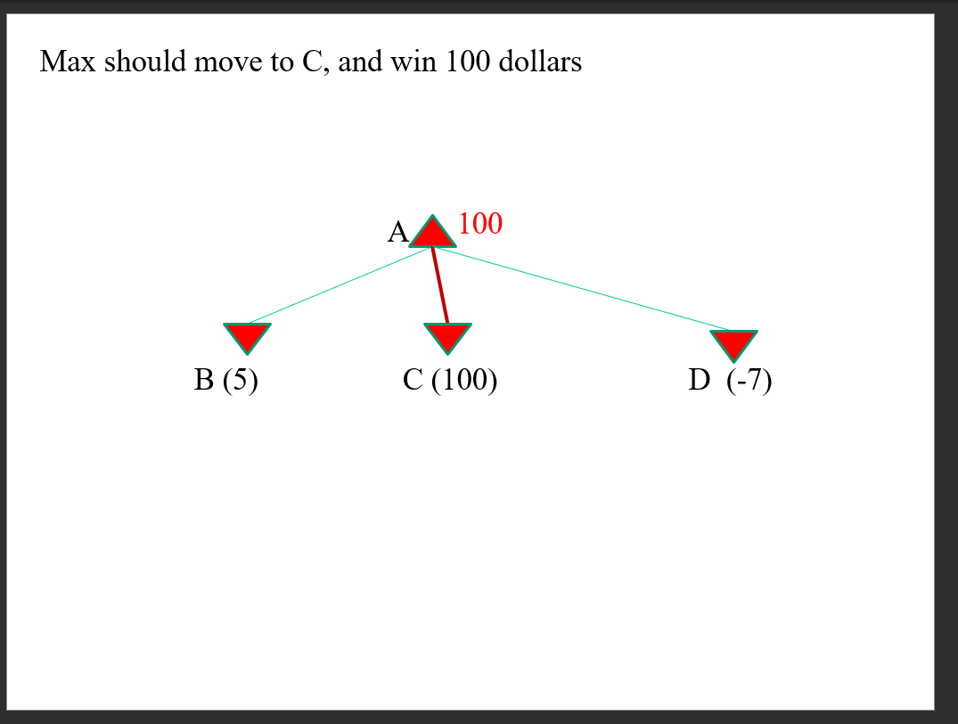

Slide 40
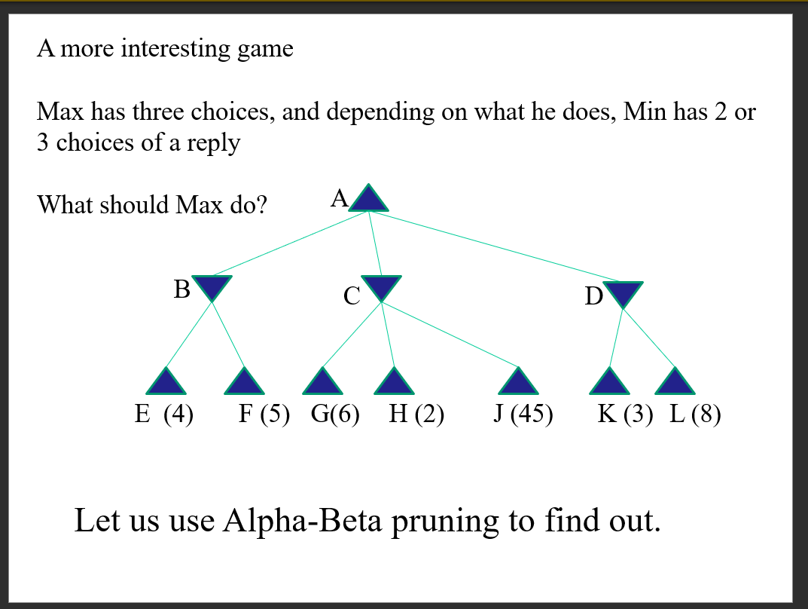

Slide 41
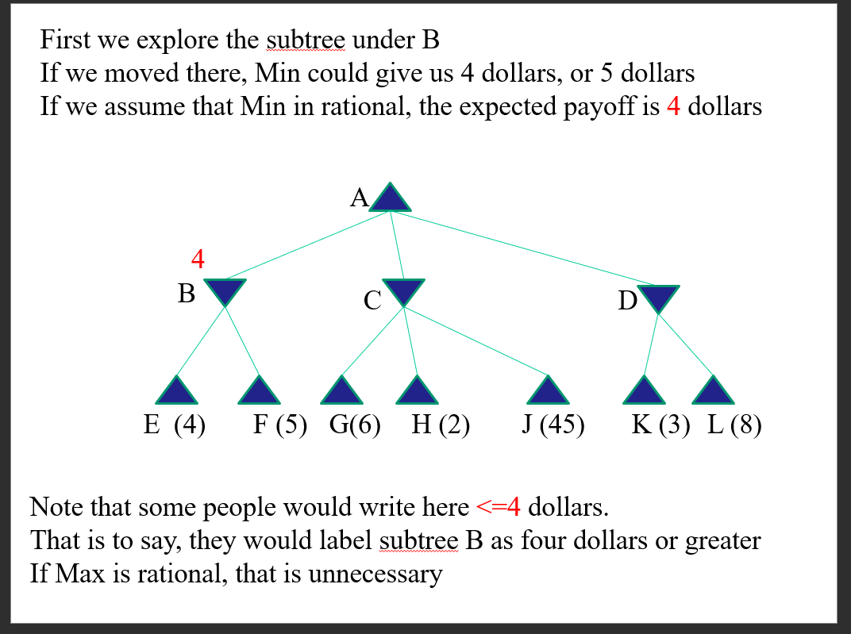

Slide 42
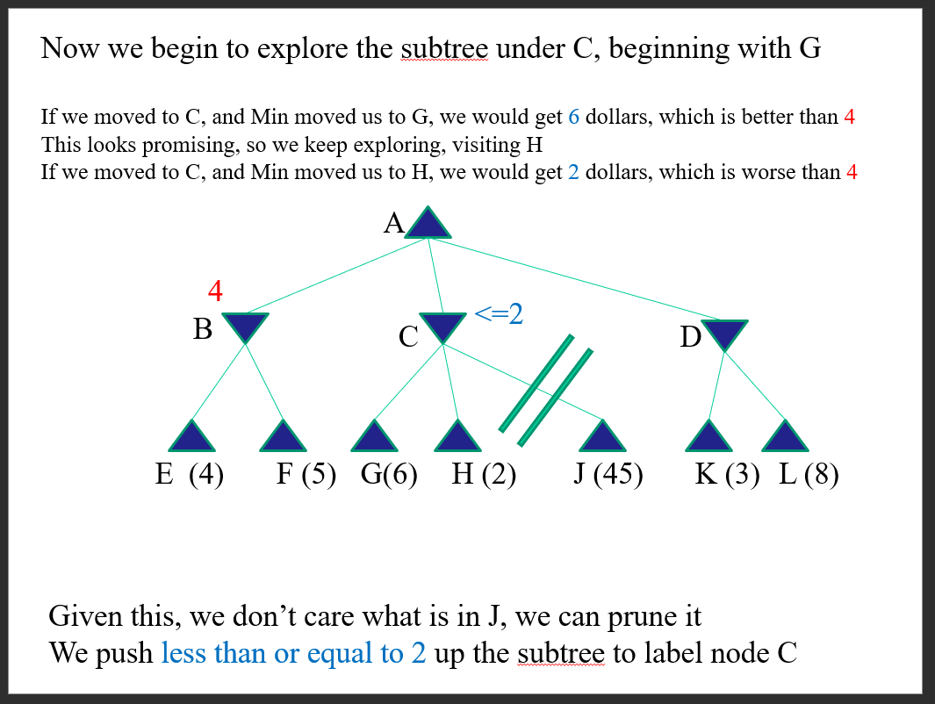

Slide 43
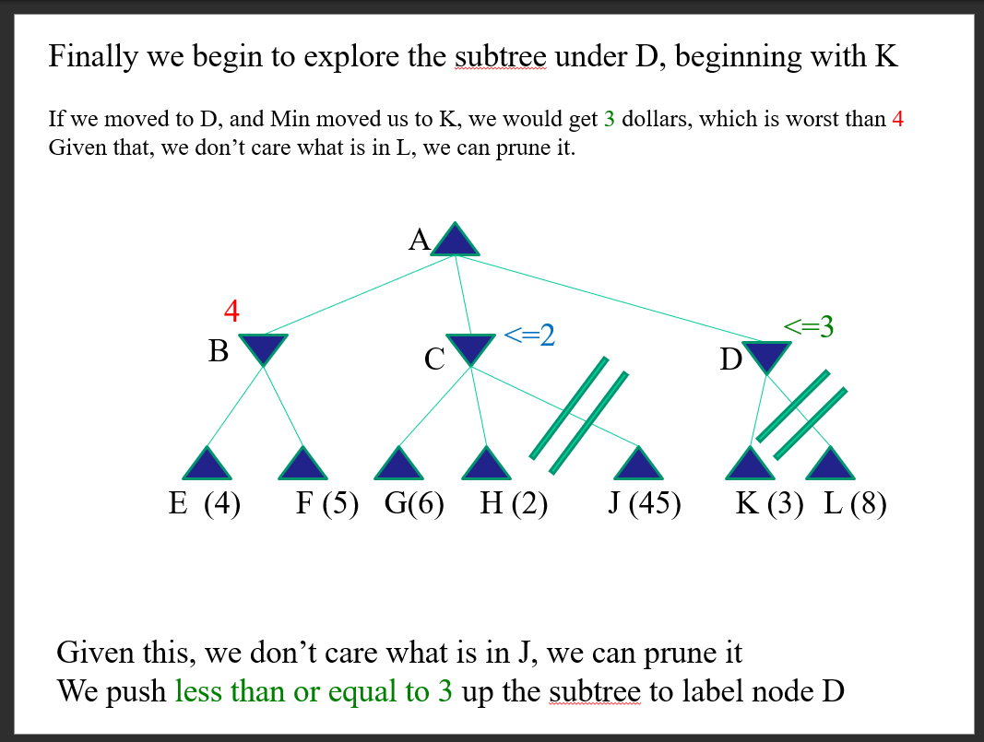

Slide 44
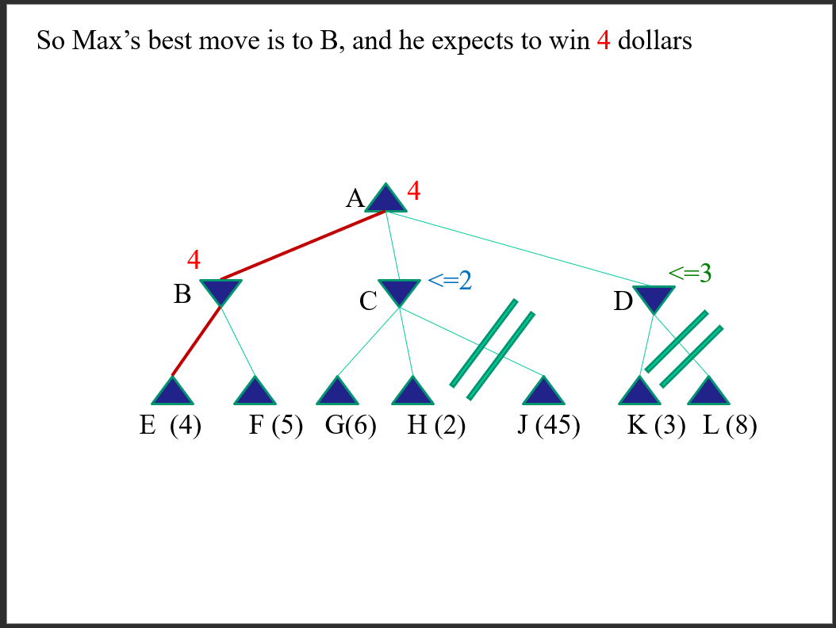

Slide 45
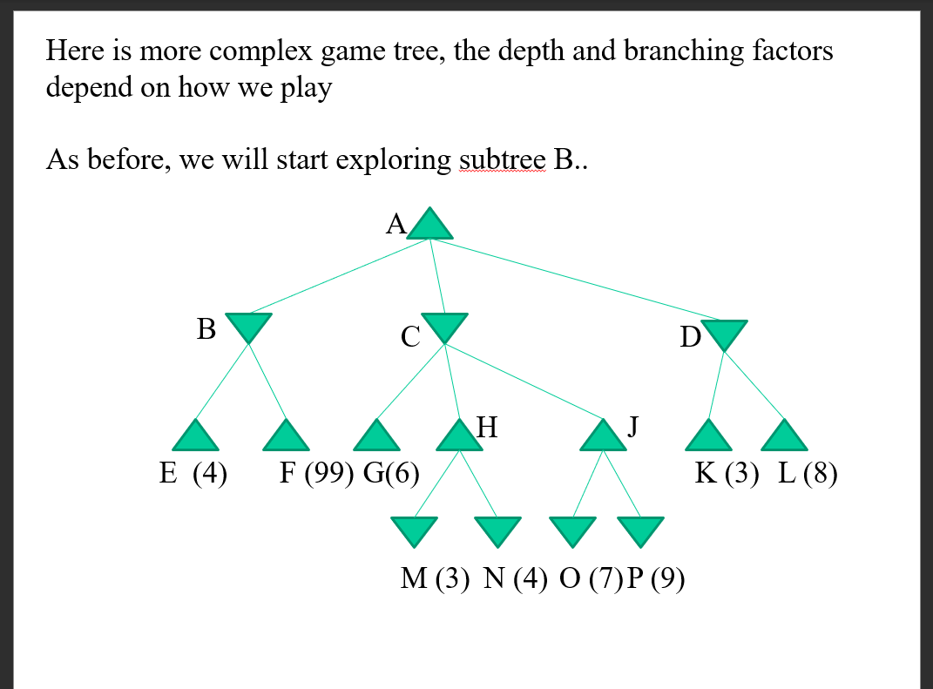

Slide 46
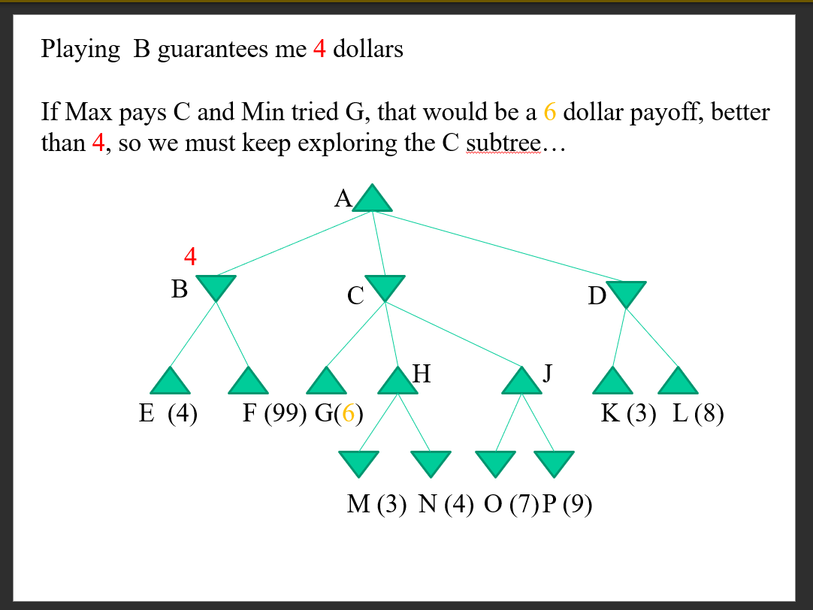

Slide 47
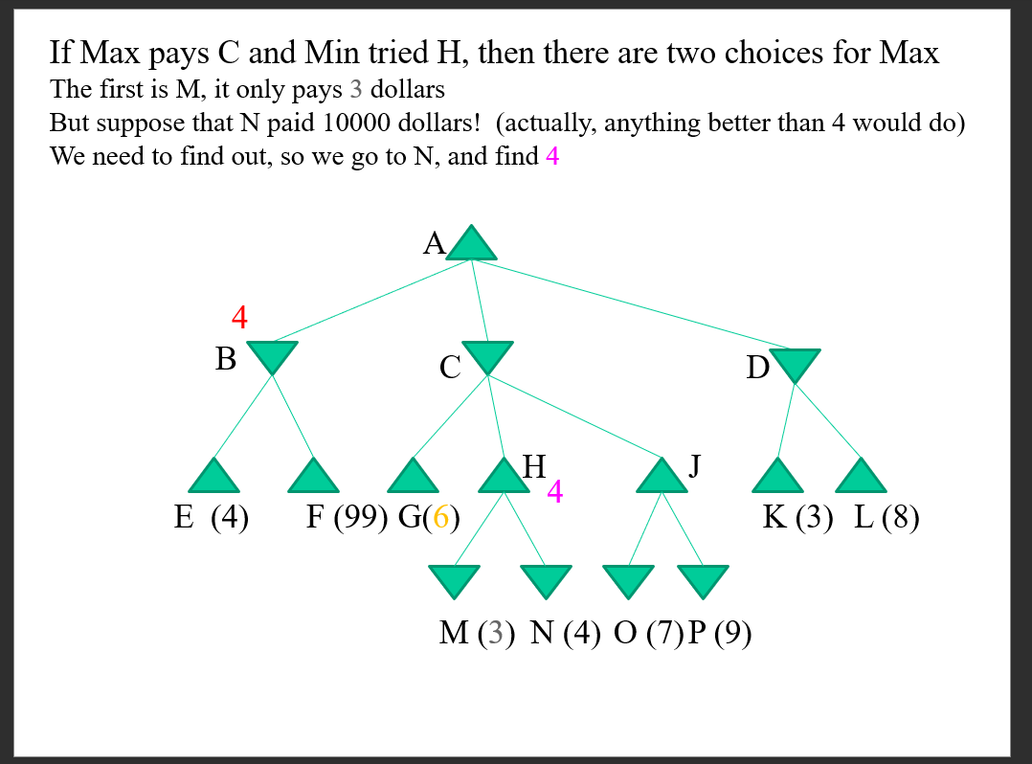

Slide 48
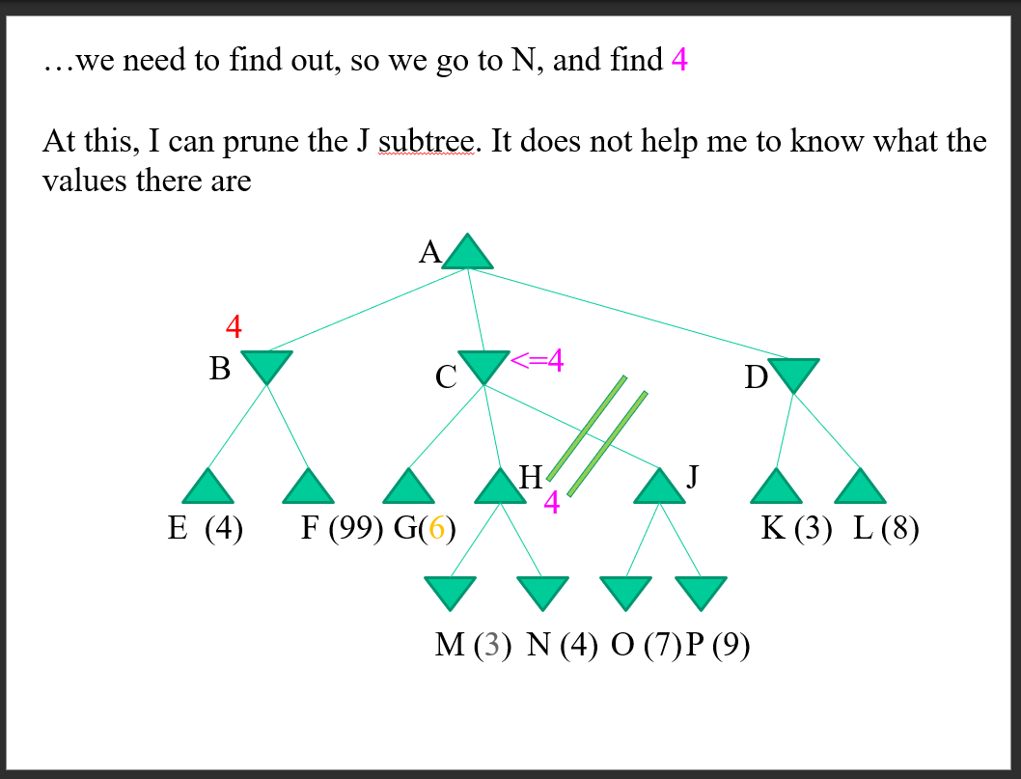

Slide 49
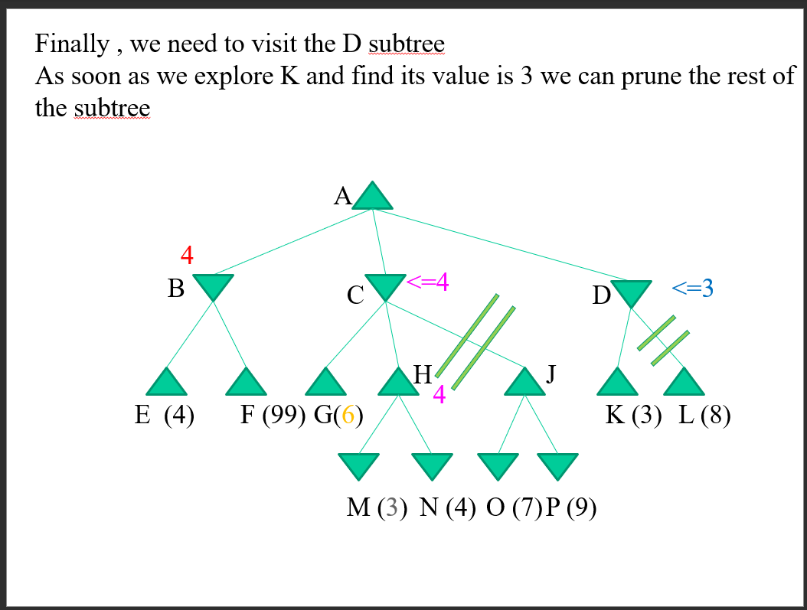

Slide 50
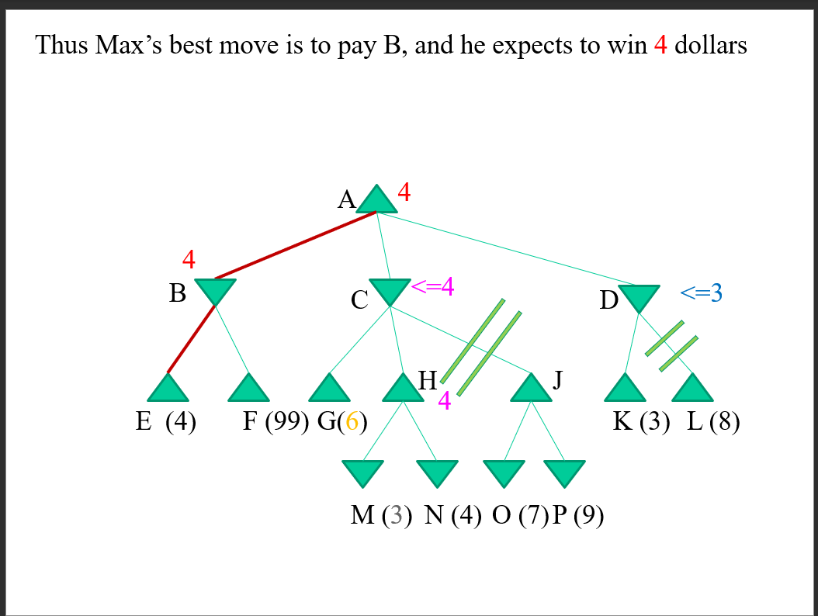

Slide 51
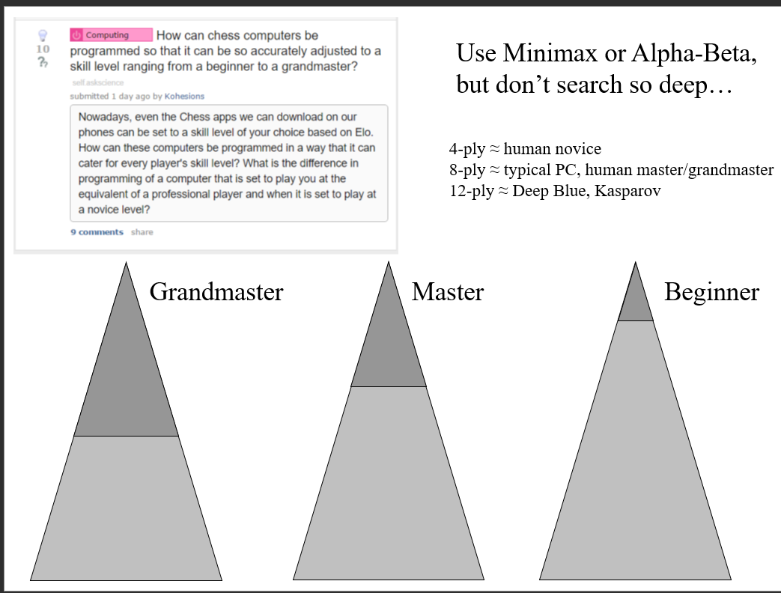

Slide 52
Solved Games
A solved game is a game whose outcome (win, lose, draw, infinite) can be correctly predicted from any position, given that both players play perfectly. Games which have not been solved are said to be “unsolved”
The most obvious way to solve a game, is to run the Minimax Algorithm all the way to the leaf nodes, and back up the scores to the root node. At that point, there are only four options
It is a win for first player
It is a win for second player
It is a draw
The game can be played forever, with no winner
It is rare we can actually do this full search to the leaf nodes

Slide 53
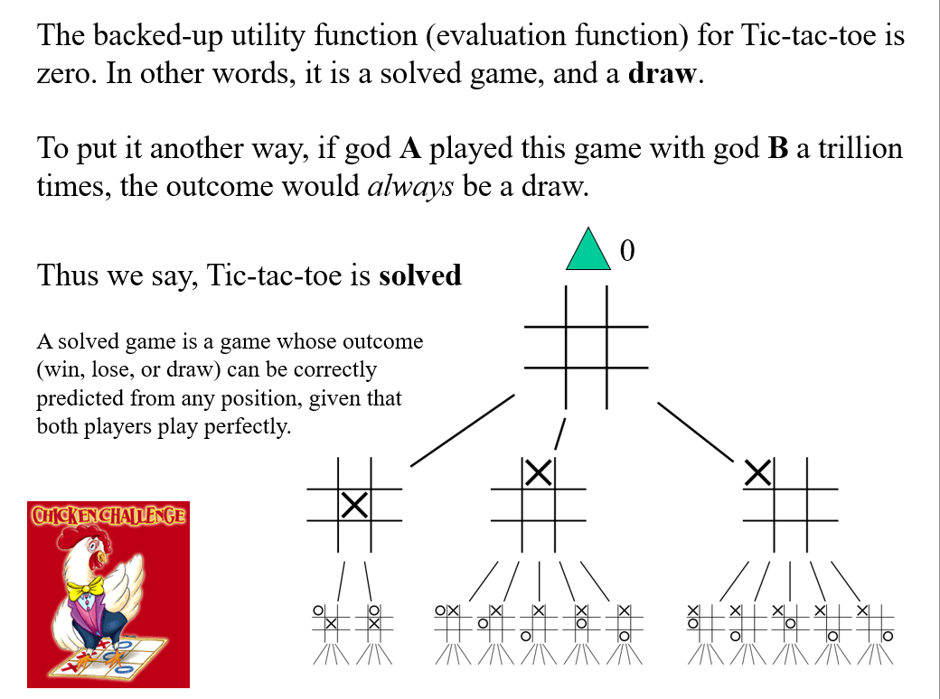

Slide 54
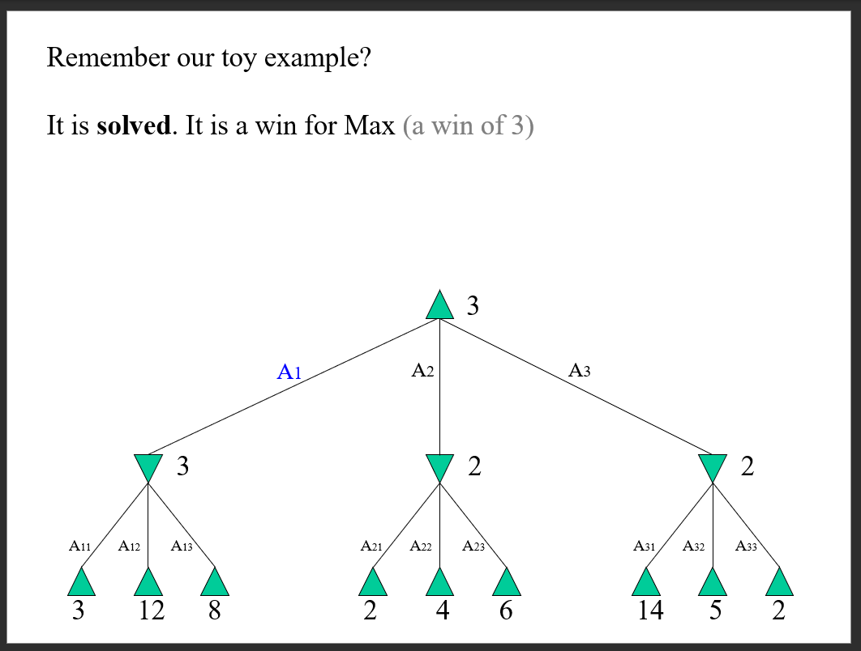

Slide 55
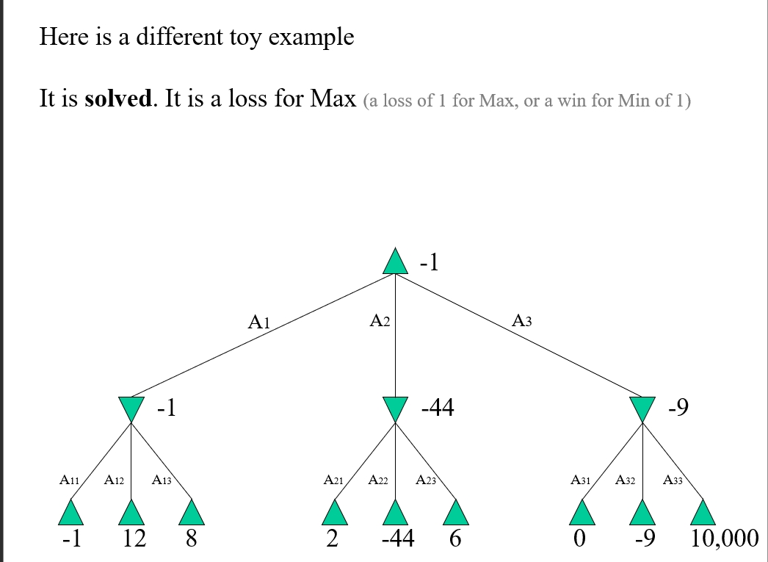

Slide 56
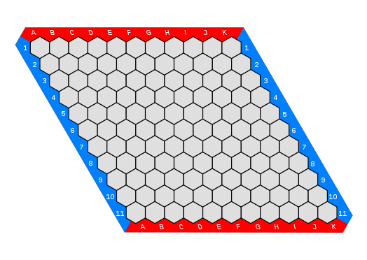
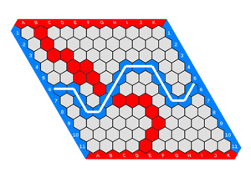

Hex is solved
Hex is a win (for Max)
One way to solve a game is to build the entire search tree and run Minimax on it
However sometimes that is not necessary…

Slide 57


Slide 58


L game is solved!
The L game is infinite
There are only 2296 possible arrangements. Only 30 of them are winning positions (15 for each color) However, both perfect players can avoid being forced into a losing position
Of course, this does not mean that if two humans play that there will be no winner/loser
On each turn, a player must first move their L piece, and then may optionally move either one of the neutral pieces. The game is won by leaving the opponent unable to move their L piece to a new position.
Pieces may not overlap or cover other pieces. On moving the L piece, it is picked up and then placed in empty squares anywhere on the board. It may be rotated or even flipped over in doing so; the only rule is that it must end in a different position from the position it started—thus covering at least one square it did not previously cover.
To move a neutral piece, a player simply picks it up then places it in an empty square anywhere on the board.
Play online: https://hwwmath.looiwenli.com/l-game
Blue has won, red has no move

Slide 59
Checkers is Solved!
Checkers is a draw
The game of checkers has roughly 500 billion billion possible positions (5 x 10^20). The task of solving the game, determing the final result in a game with no mistakes made by either player is daunting. From 1989 to 2007, almost continuously, dozens of computers have been working on solving checkers, applying-state-of-the-art artificial intelligence techniques to the proving process

Slide 60


Slide 61


Slide 62
Review
For Adversarial Search
Minimax is the optimal algorithm
We can almost never use Minimax, because of its time complexity.
We can use depth-limited Minimax, to go as deep as possible in the time allowed
A clever pruning trick alpha-beta search, let us go about twice as deep (in the best case)
Since that is all there is for search (but see later), all the research is spent on better evaluation functions

